Slide 1
Species as datapoints Comparative Methods Biology 683 Heath Blackmon

Slide 2
The Problem
Does body size impact brain size?
Does flight effect speciation rate?
Does the evolution of some traits make species more likely to go extinct?
Do structures in predators and prey coevolve?
Are the expression level of some genes maintained over evolutionary time scales?
How many times have eyes evolved?
Some questions are hard to ask with experimental studies!

Slide 3
classes of problems
Traditional comparison types
Does A impact B
Is A different from B
Mode of evolution
Does the state of A impact the evolution of B
Do A and B change at different rates

Slide 4
The Problem
An example from R

Slide 5
Solutions
Calculating independent contrasts
Only good for two continuous traits
Treating a phylogeny as a covariance matrix
PGLS
Creating a process based model that explicitly incorporates the phylogeny into the likelihood calculation
BAMM
Diversitree
Simulation using a monte carlo approach

Slide 6
Independent Contrasts
library(ape)
pic(tree, x)

Slide 7
Assumptions
If our trait does not fit a Brownian motion model then we may have biased results.
If our branch lengths are inaccurate we will have error.
If we misplace taxa we will have error and reduced power.

Slide 8
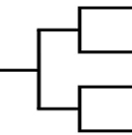
Phylogeny as a covariance matrix
 | A | B | C | D
A | 1 | 0.66 | 0.33 | 0.33
B |  | 1 | 0.33 | 0.33
C |  |  | 1 | 0.66
D |  |  |  | 1
Species A
Species B
Species C
Species D
0 1 2 3
Mathematically it can be shown that phylogenetic independent contrasts are a special case of this approach

Slide 9
Phylogeny as a covariance matrix
library(ape)
Library(nlme)
pglsModel <- gls(y ~ x,
correlation = corBrownian(phy),
data = data)
This is a less restricted approach because it allows us to fit different correlation structures. Still can be difficult/impossible to deal with discrete variables.

Slide 10
Process based model
Process based models can be developed where we calculate the likelihood of our data given a model and the tip states. These models can include things like speciation, extinction, sampling bias, discrete and continuous characters.

Slide 11
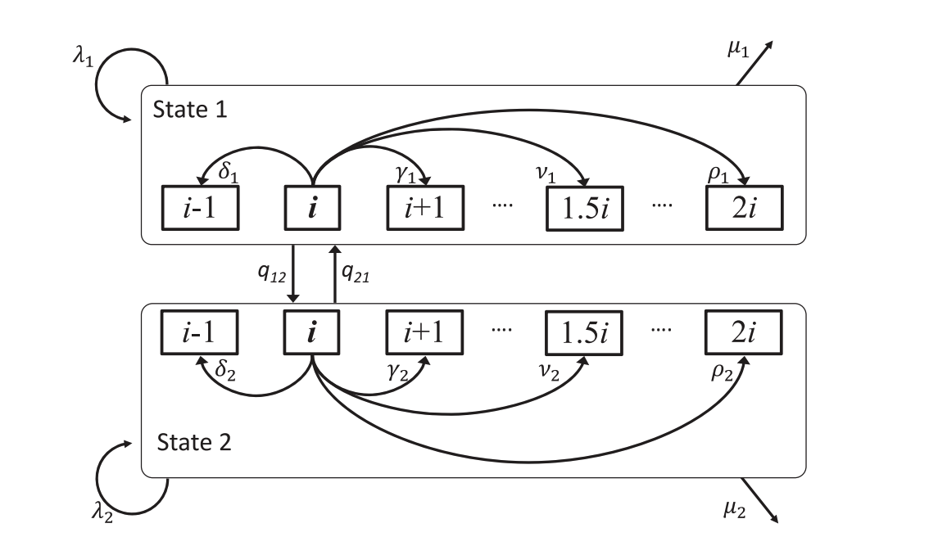
Example with chromosomes
10
11
22
23

Slide 12
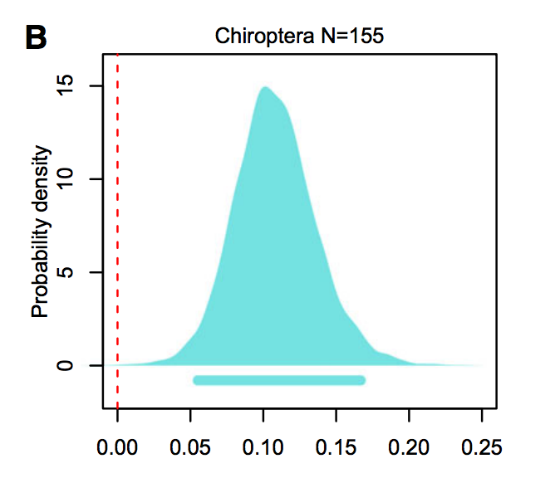
Example with chromosomes
With process based models we are usually interested in the parameters of the model and do model comparison to find the best model or Bayesian analyses where we compare parameters in the model

Slide 13
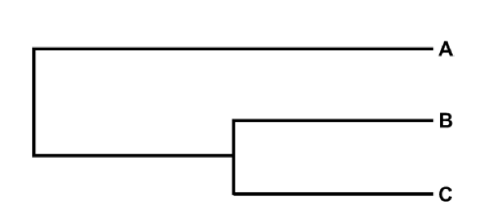
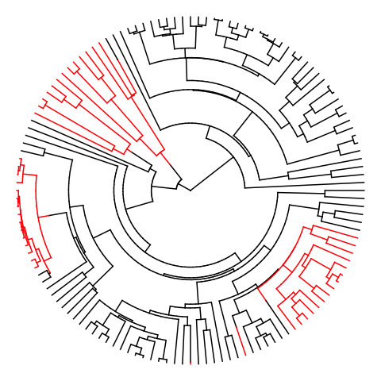
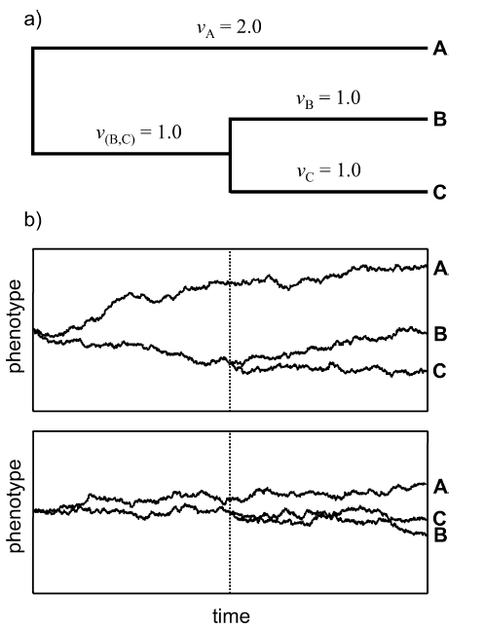
Example from beetles
Single parameter:
σ² the “drift” parameter
vs.
σ²
σ² & σ²
From Revell 2008

Slide 14
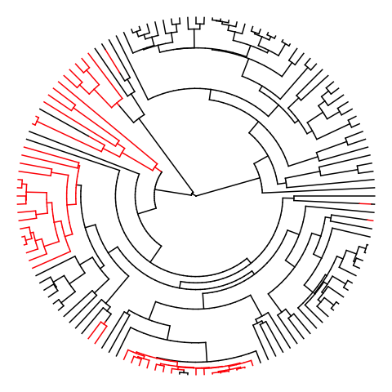
Effect of wing loss on rate of chromosome evolution
Example from beetles
2 rate model preferred on all
500 trees max p-val < 0.01
Winged
Wingless
Winged σ² = 1.5 Wingless σ² = 9.1

Slide 15
Estimation via Monte Carlo
Using regular stats test then simulating a lot of data and getting a null distribution of stats (like the f-statistic if you are doing anova). These are implemented for most things you might want.
APE, Geiger, and Phytools
Simulating data and getting a null distribution for any value you are interested in.

Slide 16
Estimation via Monte Carlo
Using existing stats:
library(geiger)
fit <- aov.phylo(y~x, phy, nsim=100)
Creating your own tests and Monte Carlos isn’t hard

Slide 17
An example from Hymenoptera
Hypothesis: Eusociality should lead to selection for higher recombination and by extension higher chromosome number.
Sherman 1979

Slide 18
An example from Hymenoptera
On average one crossover per arm per meiosis:
1
1
1
1
1
1
1
1
1
1
1
1
1
2
2
2
2
2
2
2
2
2
2
2
2
2
With 1 chromosome:
3
3
3
3
3
3
3
3
3
3
3
3
3
4
4
4
4
4
4
4
4
4
4
4
4
4
5
5
5
5
5
5
5
5
5
5
5
5
5
6
6
6
6
6
6
6
6
6
6
6
6
6
♀
♂
5 Genotypes
8 Genotypes
♀
♂
1
1
1
1
1
1
1
1
1
1
1
1
1
1
1
1
1
1
1
2
2
2
2
2
2
2
2
2
2
2
2
2
2
2
2
2
2
2
3
3
3
3
3
3
3
3
3
3
3
3
3
3
3
3
3
3
3
With 3 chromosomes:
4
4
4
4
4
4
4
4
4
4
4
4
4
4
4
4
4
4
4
5
5
5
5
5
5
5
5
5
5
5
5
5
5
5
5
5
5
5
6
6
6
6
6
6
6
6
6
6
6
6
6
6
6
6
6
6
6

Slide 19

An example from Hymenoptera
Standard ANOVA
p-value < 0.001
Phylo - ANOVA
F-statistic = 70.5,
p-value = 0.23
■ Eusocial
■ Solitary
1 60
Chromosomes

Slide 20
Origins of haplodiploidy
Bull’s hypothesis
Species with relatively few chromosomes should experience transitions to haplodiploidy more frequently than species with many chromosomes.
Bull 1979, 1983

Slide 21
Origins of haplodiploidy
2 XY
16% of genome
1
2
X
1
2
X Y
1
2
X
♀
♂
♂
Fusion between chromosome 2 and X; followed by degeneration of neoY
1 XY
50% of genome
1
1
1
X
X Y
X
♀
♂
♂

Slide 22
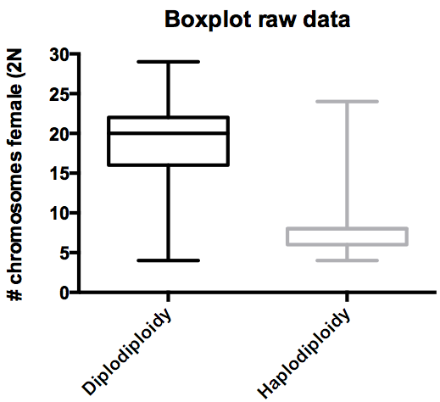
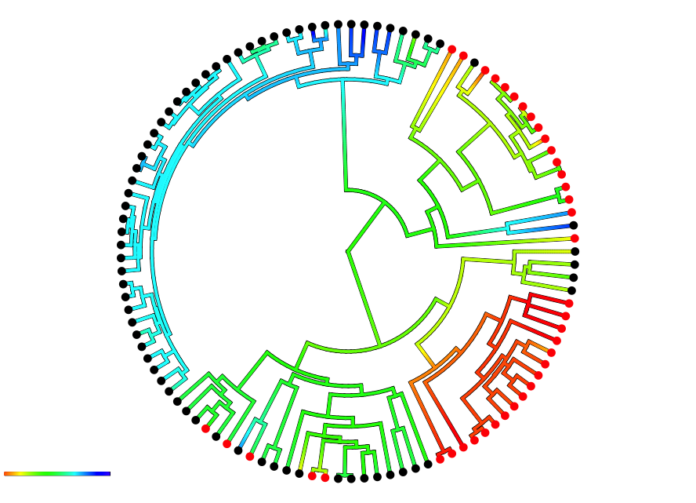
Origins of haplodiploidy
■ Diplodiploid
■ Haplodiploid
4 29
Phylo - ANOVA
F-statistic = 97.8,
p-value < 0.001

Slide 23
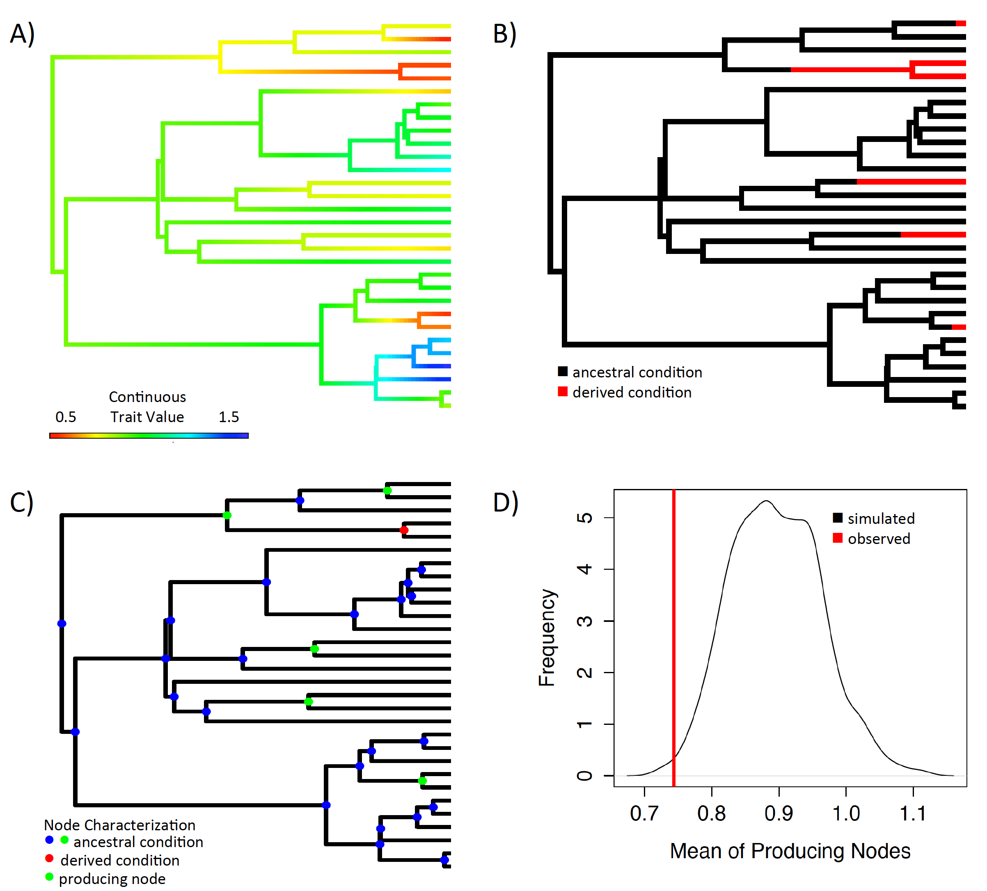
Ancestral condition test
1
15

Slide 24
Ancestral condition test
Diplodiploid
Haplodiploid

Slide 25
Ancestral condition test
7 8 9 10 11

Slide 26
Section 4: Origins of haplodiploidy
Origins of
Haplodiploidy
P-value = 0.019
Null

Slide 27
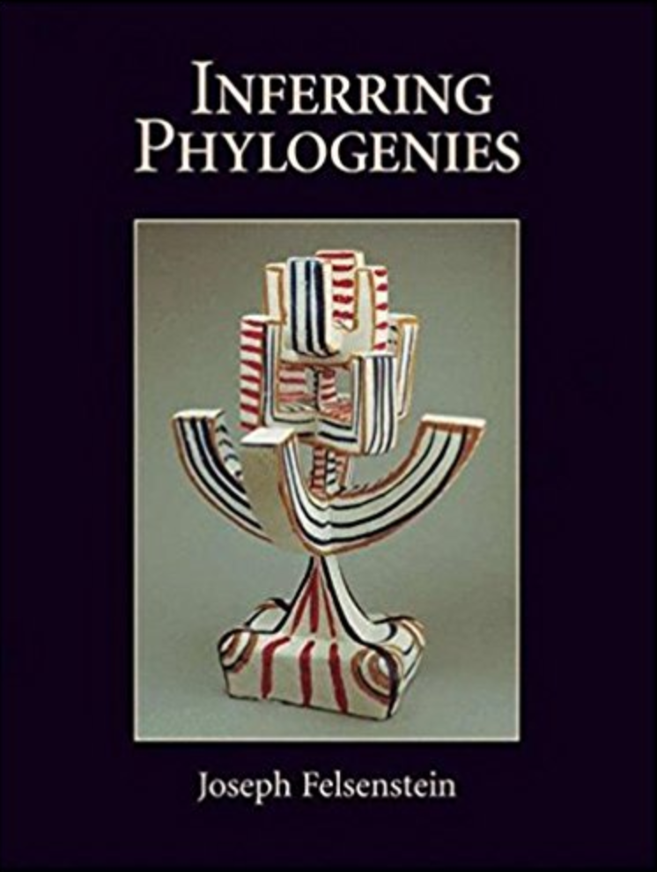
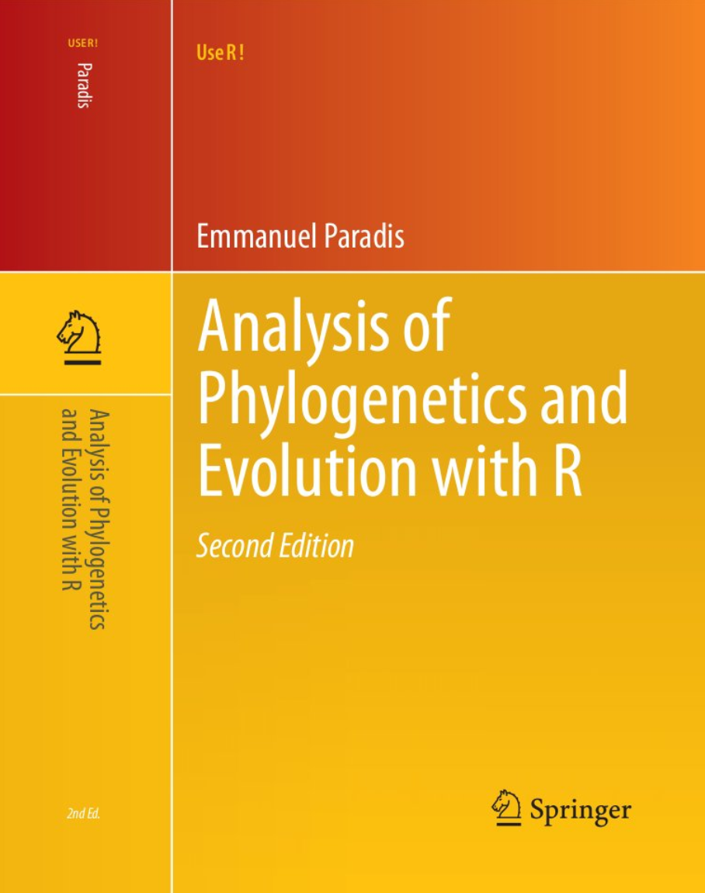
Resources and Prep
You can answer cool questions with comparative approaches!
My door is always open
PCM book by Luke Harmon
For Thursday make sure that you have APE installled!
CRAN Taskview
Workshops
Bodega – Bayesian/cheap
MBL – More molecular/very expensive

